Slide 1


A Line by Line Translation of Ibn Al-Ha’im’s 1402 poem "Al Mkni fi’l-jabr wa’l-muqābala" "Exposition of Algebraic Operations"
Ishraq Al-Awamleh
ishraq@nmsu.edu
Department of Mathematical Sciences
New Mexico State University
MAA MathFest 2017, Chicago, IL
July 27, 2017
Download presentation from: ishraq.me

Slide 2
Background (The story behind this work)
Suggestion from an audience member
Graduate math course NMSU
Finding the poem
MathFest 2016
Commentary
MathFest 2017
line by line translation of the poem
Partial Interpretation

Slide 3
Outline
Definition of al-jabr wa’l-muqābala
About the Author: Ibn Al-Ha’im
About the poem
The poem manuscript
Translation of the “Multiplication and division” and “The six canonical forms”
Conclusions

Slide 4
Definition of al-jabr wa’l-muqābala
From Al-Khwarizmi [4](780-850 AD) the word algebra is a Latin variant of the Arabic word al-jabr.
al-jabr and al-muqubalah are two basic operations in solving equations:
Jabr was to transpose subtracted terms to the other side of the equation.
Muqubalah was to cancel like terms on opposite sides of the equation.

Slide 5
About the Author: Ibn Al-Ha’im
Full name : Ahmad bin (son of) Imad Eddin bin (son of) Ali (AKA Ibn Al Ha’im)
Mathematician and theological scholar
He was born in Egypt, 1356 – 1412 AD (753-815 AH)
He lived in Jerusalem where he taught math

Slide 6
About the Poem
Al Mkni fi’l-jabr wa’l-muqābala
Exposition of Algebraic Operations
A versified poem - consists of 59 lines
Category: instruction in arithmetic and algebra

Slide 7
Poem’s background
Never before translated into English
1402
1882
Copying of the poem in Arabic
(writer: Abdel fattah)
4-1888
First commentary of the poem in
Arabic[3]
(writer: Taha Bin Yusuf)
8-1888
Second commentary based on the First, in Arabic[6]
(Writer: Taha Bin Yusuf)
Composition of the poem in Arabic
(Ibn Al-Ha’im)
Egyptian National Library.
Library of Congress.
Library of Congress
Source: Writer’s teacher
Shaik Hassan al- Attar Azhari
Source: Zakaria Al-Ansari
Source: Ahmad Al-Maliki

Slide 8
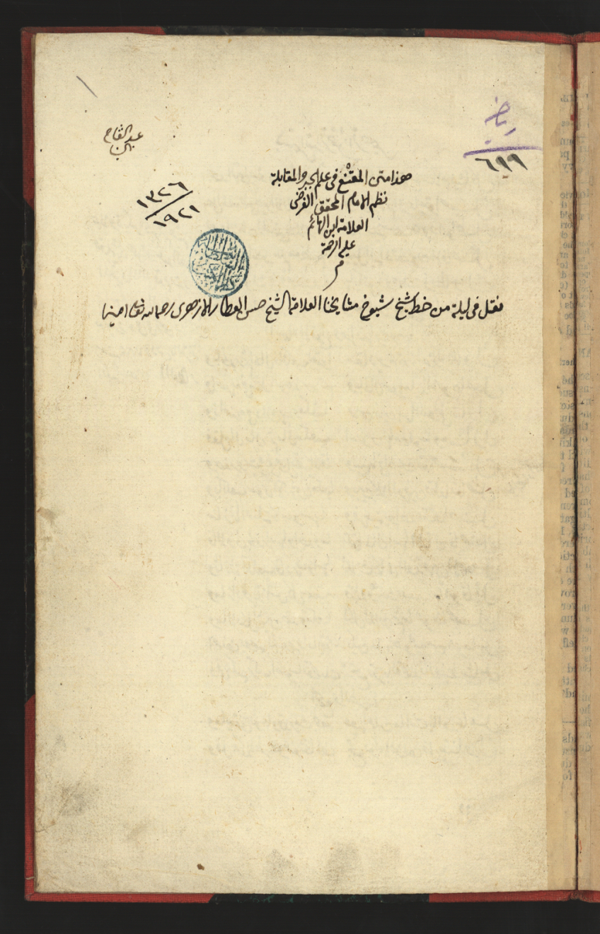
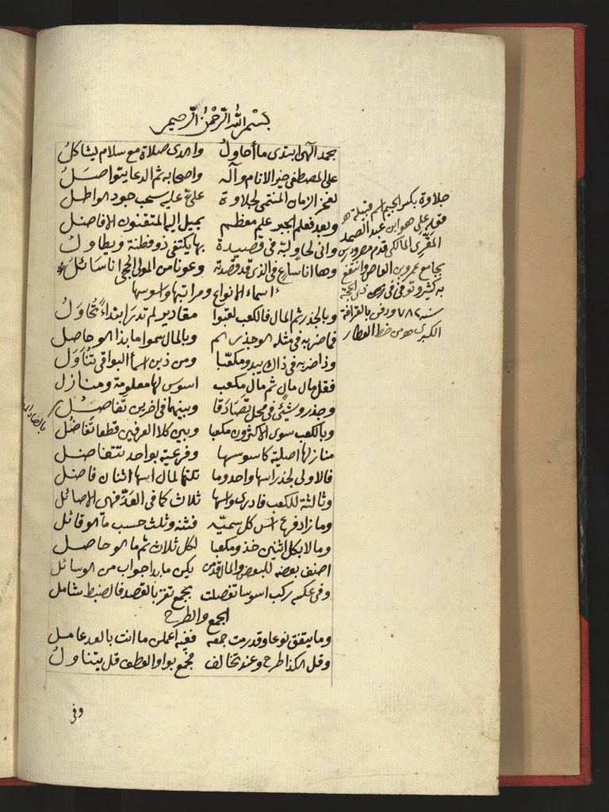
Poem Manuscript-1: Source - Egyptian National Library
Name of the copier
Section title: Names of kinds, and their ranks and exponents
Math 611
Introduction
Al Mkni fi’l-jabr wa’l-muqābala for Ibn al hai’m
Margin: explains the word Jelawa, the name of the tribe of Ibn Al-Ha’im’s teacher
The Archiving date.
Section title: Addition and Subtraction
It was written from a copy of shaik Hasan Al attar

Slide 9
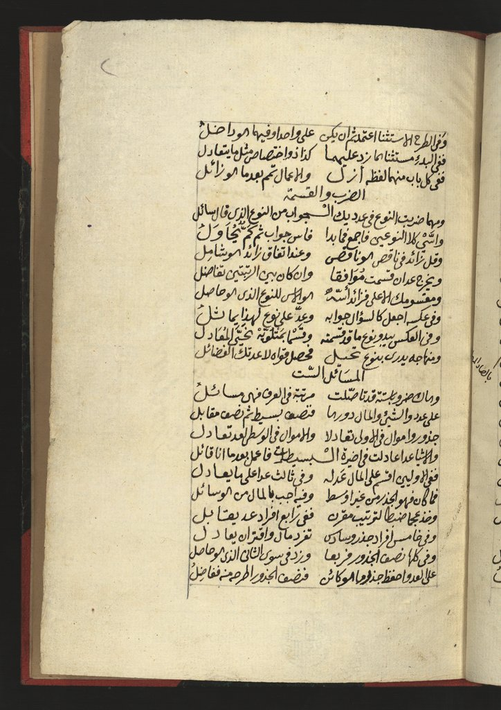
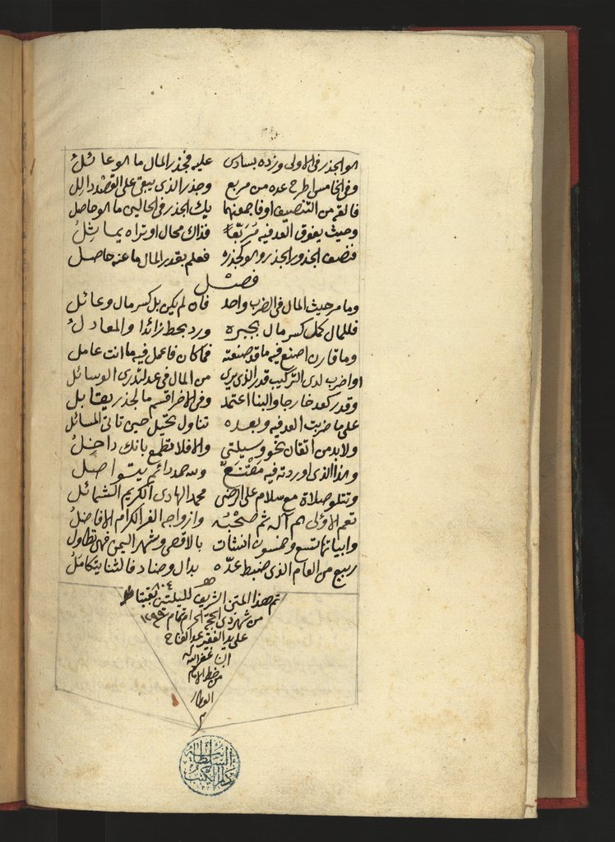
Poem Manuscript-2
Section title: Multiplication and Division
Section title: Wrap up
It was copied in 1299 AH (1882 AD)
by Abdel Fattah, citing the copy of his teacher, Shaik Hassan al- Attar Azhari, as his source.
Section title: The six canonical equations

Slide 10
Poem Sections: Names of unknown kinds, their ranks and exponents (1)
Jidhr (root) means a number, its plural is ajdhar.
Shay (thing) means unknown (our modern x), its plural is Ashya’.
Māl means a square that can be used with both number and x, its plural is amwāl.
Ka’ab means a cube that can be used as cube of a number or a cube of x , its plural is ak'ab.
Aus means exponent.
Al-Khwarizmi defined simple numbers to be numbers that are neither squares nor roots and mentioned that simple numbers, roots, and squares are the kinds of the unknown numbers.

Slide 11
The main unknown kinds of numbers (2)
Names of kinds | Exponents of kinds | Ranks of kinds
Thing(Root) | 1 | First
Square | 2 | Second
Cube | 3 | Third
Secondary kinds: e.g., mal mal (square square)
Simple number has no rank

Slide 12
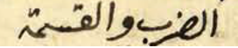
Translation of the section “Multiplication and division”
Line 27
Multiplication and Division

Slide 13
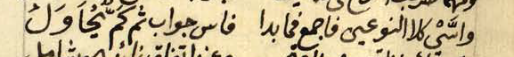
Line 28
Whenever you multiply a kind by a number,
the answer will be of the same kind a seeker asked about.
Line 29
Whenever multiplying two kinds add the exponents of the two kinds
to obtain the exponent of the result, and then obtain the quantity of the result.

Slide 14
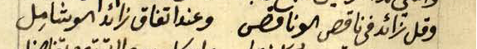
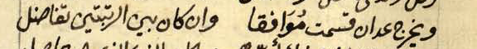
Line 30
And you say, additive term multiplied by subtractive term gives subtractive term,
but when the terms are similar [either both are additive or subtractive], additive term is obtained.
Line 31
When dividing two kinds of the same rank, the result is a number.
And if the ranks are different,

Slide 15
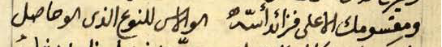
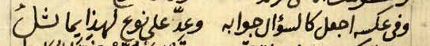
Line 32
when the numerator has higher rank [than the denominator], the excess value of exponents
is the exponent of the resulting kind.
Line 33
And [when] the reverse of this [the numerator has lower rank than the denominator], make the answer be the question,
and the same rule applies when dividing a number by a kind.

Slide 16
Line 34
For the reverse [i.e., dividing any kind by a number], the result will have the same kind [as the question].
And for the cases [i.e., lower rank by higher rank, or number by kind] remove the division and equate the terms.
Line 35
And with this method using mathematics,
you should improve your skills so that others will not surpass you.

Slide 17
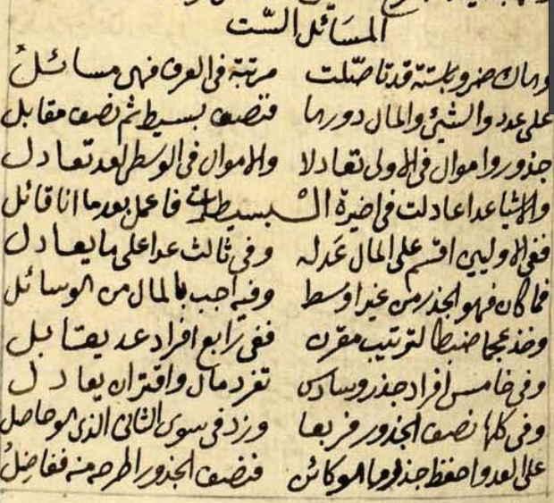
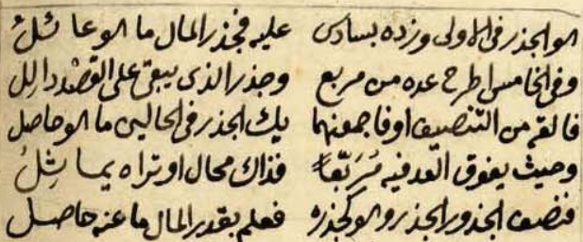
Poem Section: The six canonical equations
The six equations (types) include just number, jidhr (root), and māl(square).

Slide 18
The six canonical equations
Simple equations
Compound equations
Type I
Squares equal roots
Type II
Squares equal a number
Type III
Roots equal a number
Type IV
The numbers are isolated
Type V
The roots are isolated
Type VI
The squares are isolated

Slide 19
Translation of the section “The six canonical forms”

Slide 20
Line 36 The Six Equations [six canonical forms]
Line 37
And take these six original forms,
ordered, and they are known as equations.

Slide 21
Line 38
A number and a thing and a square, they [the six equations] encompass,
half of them are simple and the other half are the opposite [compound].
Line 39
Roots and squares in the first one [first equation] are equated,
and squares in the intermediate one [the second equation] are equated with numbers.

Slide 22
Line 40
And things [or roots] are equated with numbers in the last one [third equation] of the simple equations,
and then you follow what I say.
Line 41
In the first two [simple equations], divide [both terms: roots and numbers, respectively ] by the number of squares,
and in the third [equation] divide the number by what it's equated to [the number of roots].

Slide 23
Line 42
The result is a root except for the intermediate [second equation],
and your answer [in the second equation] will be square for the seeker.
Line 43
And take AJM [A:Adad (number), J:Jadther(root) and M:Mal (Square)] to order the others [compound equations],
in the fourth [equation] the number is isolated.

Slide 24
Line 44
And in the fifth [equation] root is isolated, and in the sixth [equation], ,
square is isolated and is equated [in the fifth, root is equated to square and numbers, and in the sixth, square is equated to roots and numbers]
Line 45
[To solve the compound equations] In all of them, square the half of the roots
and add the result, except for the second [fifth compound equation],

Slide 25
Line 46
to the number, and remember the [new] result,
then subtract the half of the roots from the [new] result and so the [final] result
Line 47
is the root for the first [fourth compound equation]. And in the sixth [third compound equation] you have to add [the half of the root to the new result],
and the root of the square is the resulting outcome.

Slide 26
Line 48
And in the fifth [compound equation] [ case 1] subtract the number from the square [of the half of the root],
and the root of the result indicates the target.
Line 49
Subtract it [ the target] from the half of the roots or add them together;
the root in both cases is the result.

Slide 27
Line 50
And when the number exceeds the square [of the half of the roots] [case 2],
it's impossible [to find the root]. If they are equal [the number is equal to the square of the half of the root] [case 3],
Line 51
then the half of the roots is the root sought,
and square is obtained from the root [by squaring the actual result].

Slide 28
Conclusions
Ibn Al-Ha’im put Al-Khwarizmi’s mathematical results in a poem.
For centuries, this was one way that Al-Khwarizmi’s results were presented.
This is an example of the preservation of his mathematics in poetic form.
Another example: “Ibn al-Yāsamīn’s Urjūza fi’l-
jabr wa'l-muqābala”12th century.

Slide 29
References
[1] (Egyptian National Library)
http://www.alukah.net/library/0/99918/
[2] (Library of Congress)
https://www.wdl.org/ar/item/2844/
[3] (First interpretation of the poem)
https://dl.wdl.org/3202/service/3202.pdf
[4] (Definition of al-jabr wa’l-muqābala by Mohammed ibn-Musa al-Khowarizmi)
http://www.und.edu/instruct/lgeller/algebra.htm
[5] Abdeljaouad, Mahdi, 2005b. “12th century algebra in an Arabic poem: Ibn al-Yāsamīn’s Urjūza fi’l-jabr wa'l-muqābala”. Llull 28, 181-194.
[6] (Second interpretation of the poem)
https://www.wdl.org/en/item/4291/

Slide 30
[7]Khuwarizmi, Muhammad ibn Musá. 1831. The algebra of Mohammed Ben Musa, 1831, Edited and translated by Fredrick Rosen, London Printed for the Oriental Translation Fund and sold by J. Murray http://www.wilbourhall.org/pdfs/The_Algebra_of_Mohammed_Ben_Musa2.pdf

Slide 31
Acknowledgments
New Mexico State University, Department of Mathematical Sciences.
MAA MathFest

Slide 32
Thank you
ishraq@nmsu.edu
ishraq1980@yahoo.com
This presentation: ishraq.me

